Slide 1
Python Programming Language
Lecture 4: Operator, String and Problem Solving
Hafsa Sultana
Computer Science and Engineering
Khulna University

Slide 2
Today’s Learning Objectives
Types of Operators
Exercise of Operators
String
String Slicing
Check String
String Functions/ Methods
Practical Exercises,
Hafsa Sultana, CSE, KU

Slide 3
Python Operators
Operators are used to perform operations on variables and values.
Examples: +, -, *, /, ==, !=
Types of Operators:
Arithmetic Operators
Comparison (Relational) Operators
Assignment Operators
Logical Operators
Bitwise Operators
Membership Operators
Identity Operators
Hafsa Sultana, CSE, KU

Slide 4
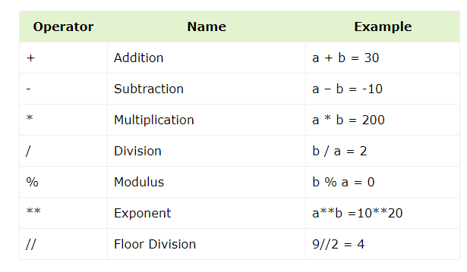
1.Arithmetic Operators:
Hafsa Sultana, CSE, KU

Slide 5
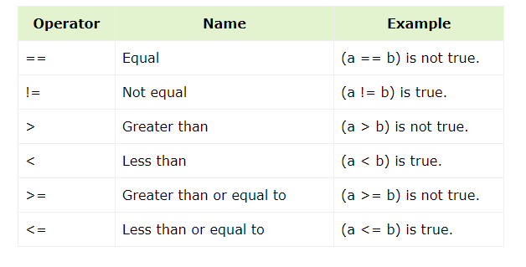
2. Comparison Operators:
Hafsa Sultana, CSE, KU

Slide 6
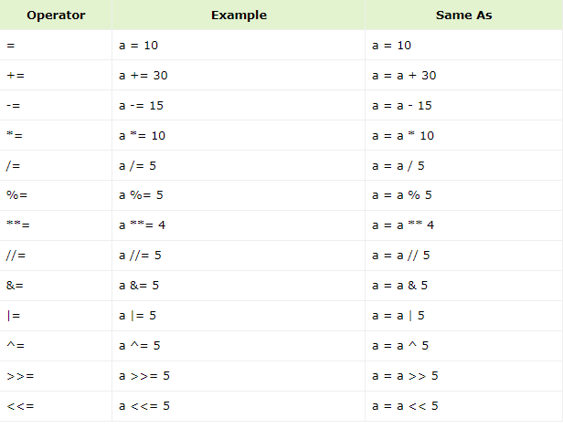
3. Assignment Operators:
Hafsa Sultana, CSE, KU

Slide 7
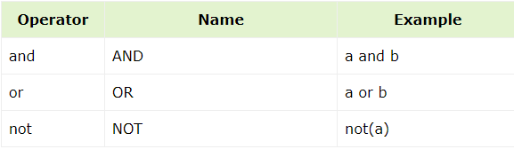
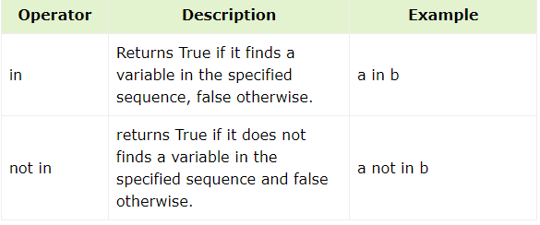
4. Logical Operators:
5. Membership Operators:
Hafsa Sultana, CSE, KU

Slide 8
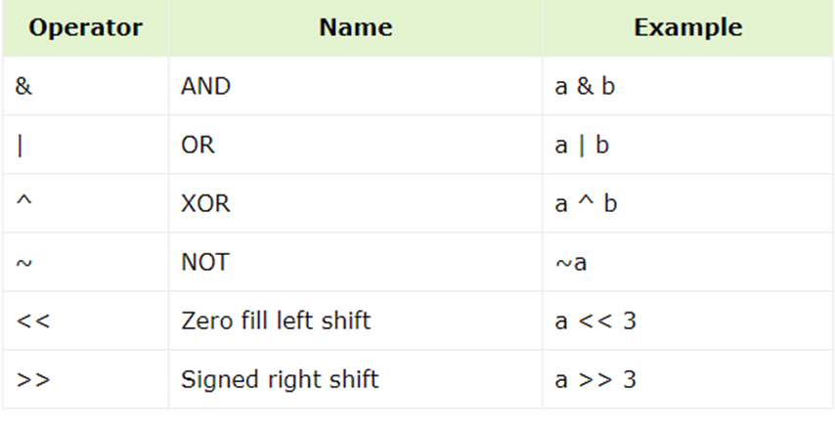
6. Bitwise Operators:
Hafsa Sultana, CSE, KU

Slide 9

7. Identity Operators:
Hafsa Sultana, CSE, KU

Slide 10
Operator
Precedence:
Example1:
print((6 + 3) - (6 + 3))
print(100 + 5 * 3)
print(5 + 4 - 7 + 3)
Example2: #Example of Python Membership Operator
a = 10
b = 20
c=b/a
list1 = [1, 2, 3, 4, 5 ]
print ("a: ", a, "b: ", b, "c: ", c, "list1:", list1)
print( a in list1)
print( b not in list1)
print( c in list1)
Hafsa Sultana, CSE, KU

Slide 11
String
str = 'Hello World!’
print (str) # Hello World!
print (str[0]) # H
print (str[2:5]) #llo
print (str[2:]) # llo World!
print (str * 2) # Hello World!Hello World!
print (str + "TEST") # Hello World!TEST
Hafsa Sultana, CSE, KU

Slide 12
String
Accessing Characters:
Example1:
message = “Khulna University”
first_letter = message[0] # ‘K'
last_letter = message[-1] # ‘y’
print(first_letter, last_letter)
Sub_str = message[-4:-1]
print(Sub_str ) # sit
Example2:
S1 = message[-10] # ‘U’
S2 = message[-17] # ‘K’
print(S1, S2)
or
length=len(message)
print(length)
S2 = message[- length] # ‘y’
print(“S2 is: ",S2)
Hafsa Sultana, CSE, KU

Slide 13
String Slicing
Extract substrings using colon (:) notation within square brackets.
Syntax: [start:end:step].
Example1:
message = "Python_Class"
substring = message[1:6] # "ython" (extracts characters from index 1 to 6)
print(substring)
Example2:
substring = message[1:8:2] # "yhnC" (extracts characters from index 1 to 8)
print(substring)
Hafsa Sultana, CSE, KU

Slide 14
Check String
Example 1:
txt = "Smiling is a kind act and the Sunnah of our beloved Prophet Muhammad (PBUH)."
print(" Sunnah " in txt) #True
Example 2:
print("expensive" not in txt)
print("Sunnah" not in txt)
find_txt = "expensive" not in txt
print("Is expensive in txt ? = ",find_txt)
Hafsa Sultana, CSE, KU

Slide 15
String Function/ Methods
Strings provide various built-in methods for manipulation:
upper(): Convert to uppercase (Ex: message.upper()).
lower(): Convert to lowercase (Ex: message.lower()).
strip(): Remove leading and trailing whitespaces (Ex: message.strip()).
find(substring): Find the index of the first occurrence of a substring (returns -1 if not found).
replace(old, new): Replace all occurrences of a substring with another substring.
count(): Returns the number of times a specified value occurs in a string
Many more! (Refer to Python documentation for the full list)
Hafsa Sultana, CSE, KU

Slide 16
String Function
my_str = " Helping others is a Sunnah “
#upper():
print(my_str.upper())
#lower():
print(my_str.lower())
#title():
print(my_str.title())
#strip():
print(my_str.strip(" "))
#find():
print(my_str.find("Sunnah")) #22
print(my_str.find("Helping")) #2
#replace():
print(my_str.replace("Helping","Supporting"))
#Supporting others is Sunnah.
#count()
print(my_str.count("i")) #2
Hafsa Sultana, CSE, KU

Slide 17
Practical Exercises
Reverse a String
Input: Hello
Output: olleH
2. Check if a String is a Palindrome
Input: Enter the String: "racecar“
Output: True
Hafsa Sultana, CSE, KU

Slide 18
Practical Exercises
3. Count the Number of Vowels in a String
Input: Enter the String: Hello
Enter the count vowel: e
Output: 1
4. Split a String by a Delimiter
Input: Enter a string: "apple,banana,orange“
Output: ["apple", "banana", "orange"] #input_string.split(',')
Hafsa Sultana, CSE, KU

Slide 19
Practical Exercises
5. You have a dataset with strings. Each string contains:
A sentence where the last character indicates the currency type (e.g., ‘$' for dollars, 'E' for euros).
The 5th, 6th, and 7th characters represent the amount of money.
Your task is to extract the amount of money and the currency type from each string.
Hafsa Sultana, CSE, KU

Slide 20
Practical Exercises
Missing char
Given a non-empty string and an int n, return a new string where the char at index n has been removed. The value of n will be a valid index of a char in the original string (i.e. n will be in the range 0..len(str)-1 inclusive).
missing_char('kitten', 1) → 'ktten'
missing_char('kitten', 0) → 'itten'
missing_char('kitten', 4) → 'kittn'
Hafsa Sultana, CSE, KU

Slide 21
Practical Exercises
non_start
Given 2 strings, return their concatenation, except omit the first char of each. The strings will be at least length 1.
non_start('Hello', 'There') → 'ellohere'
non_start('java', 'code') → 'avaode'
non_start('shotl', 'java') → 'hotlava''
Hafsa Sultana, CSE, KU

Slide 22
Practical Exercises
Make the sequence : abba
Given two strings, a and b, return the result of putting them together in the order abba, e.g. "Hi" and "Bye" returns "HiByeByeHi".
make_abba('Hi', 'Bye') → 'HiByeByeHi'
make_abba('Yo', 'Alice') → 'YoAliceAliceYo'
make_abba('What', 'Up') → 'WhatUpUpWhat'
Hafsa Sultana, CSE, KU

Slide 23
Practical Exercises
7 Sln:
print("*")
print("**")
print("***")
print("****")
print("*****")
8 Sln:
print(" * ")
print(" *** ")
print(" ***** ")
print(" ******* ")
print("*********")
9 Sln:
print(" * ")
print(" *** ")
print(" ***** ")
print(" ******* ")
print("*********")
print(" ******* ")
print(" ***** ")
print(" *** ")
print(" * ")
10 Sln:
print("*****")
print("* *")
print("* *")
print("* *")
print("*****")
11. Sln:
print("* *")
print(" * * ")
print(" * ")
print(" * * ")
print("* *")
12 Sln:
print(" * ")
print(" * * ")
print(" * * ")
print(" * * ")
print("* *")
print(" * * ")
print(" * * ")
print(" * * ")
print(" * ")
13. Sln:
print("* * * *")
print(" * * * * * * ")
print(" * * * * * * ")
print(" * * * ")
Hafsa Sultana, CSE, KU

Slide 24
Debugging Tips
Use print statements to debug.
Check variable values and types.
Hafsa Sultana, CSE, KU

Slide 25
Any Question?

Slide 26
References
https://www.w3schools.com/python/
https://www.tutorialspoint.com/python/
Hafsa Sultana, CSE, KU

